Slide 1
topological sort
Week 9
Google Slides Version

Slide 2
graphs
directed graphs have edges with direction; they point from one node to another
A directed acyclic graph has no cycles; edges will always end in a leaf node

Slide 3
searches
Depth First Search: Go to the deepest node you can find; go to each node’s child node until you can’t go further
Breadth First Search: Go to all the children of a node before moving on to the next node

Slide 4
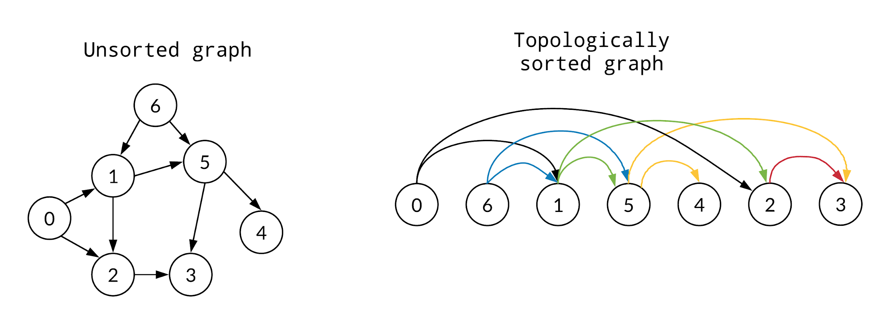
topological sort
A topological sort of a directed, acyclic graph is a linear ordering of vertices such that for every directed edge u → v, u comes before v in the ordering. Essentially, a topological sort will end up with all the vertices in a graph arranged from left to right.

Slide 5
topological sort
A topological sort combines a depth-first search with a FIFO (first in, first out) queue to order the discovered nodes in.

Slide 6
DFS
Visit each node, and record that we’ve visited it in some sort of list
We go from parent node to child node until we reach a leaf node that has no children
Then, we traverse back up; as we go back up, if we find a node that has a child that hasn’t been visited, we repeat the second step again.

Slide 7
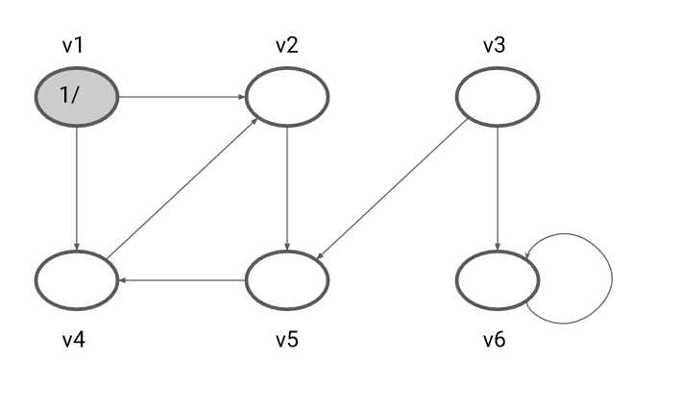
DFS

Slide 8
DFS with a FIFO queue
When you perform your depth first search, as you traverse back up and check each node against the list of already visited nodes, when you reach a node that’s on your already visited list and has no more children to visit, you add it to the queue.

Slide 9
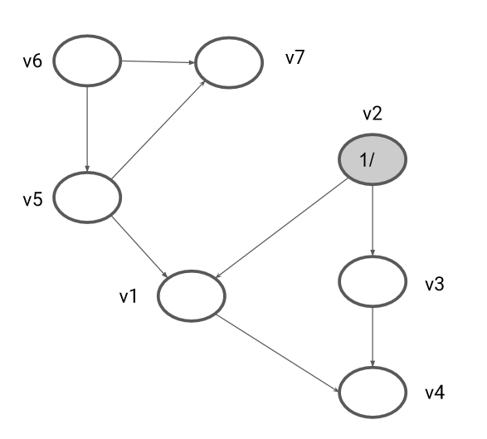
DFS with a FIFO queue

Slide 10
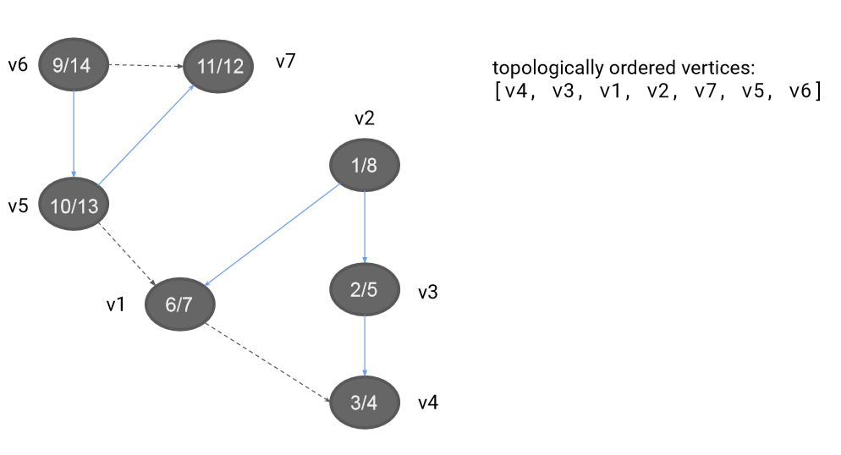
topological sort results
Note that there’s more than one possible topological sort for every DAG.

